Slide 1
Explore Community Board 03
Xiaolong Li

Slide 2
Assumptions
Winter: fell down on the street and heat hot water
Spring: Noise
Summer: Rat
Fall: pothole, street condition

Slide 3
Top 10 complains(Spring)

Slide 4
Top 10 complains(Summer)

Slide 5
Top 10 complains (Fall)

Slide 6
Top 10 complains(Winter)2012-2015

Slide 7
Assumptions changed or not?
Spring no change
Summer From rodent to Noise
Fall From street condition to Noise and Heating
Winter not a big change it is Heating

Slide 8
Heat/ Hot water Complains

Slide 9
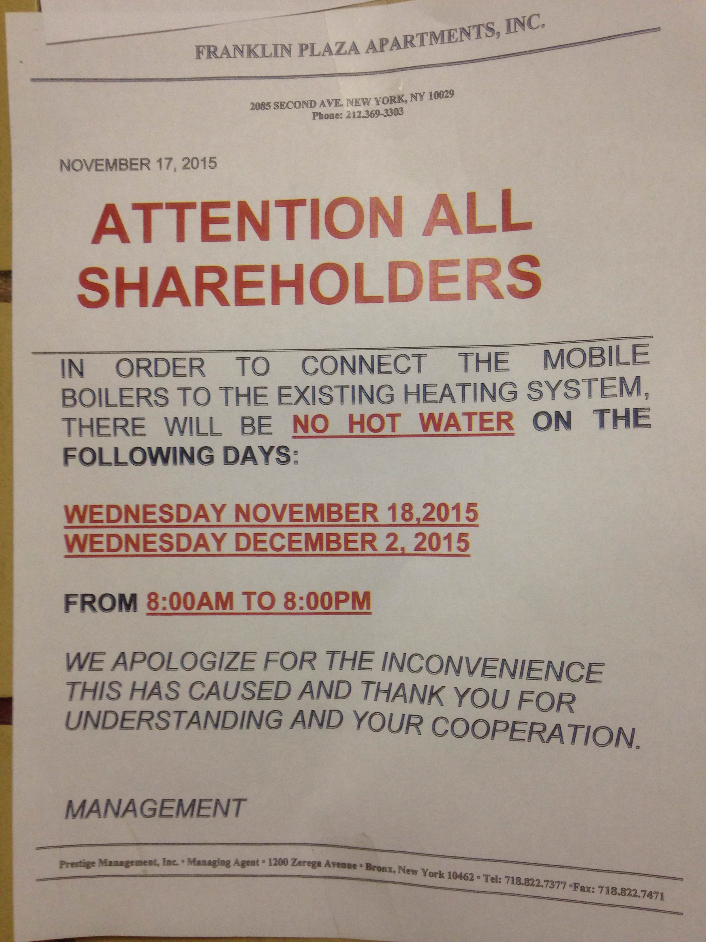

Slide 11
2012 compare 2013
2012 January November and December are the most heat hot water complains months, especially November is the pick time.
Compare 2012 to 2013, Heat Hot water total complains decrease a lot. ( Even show 2013 summer is colder than 2012)
From 2012 to 2013 complians are decresed. Especially Heating etc major problems.

Slide 12
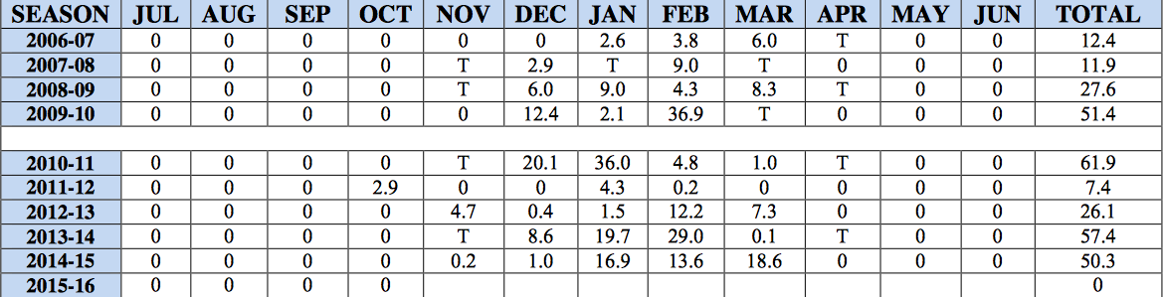
Central Park Snowfall record

Slide 14
2014-2015 Comparison
Heating complains decrease, but hot water complains increased
From 2015 January get into a pick time to Hot water complains, almost through the whole year, it is a big problem now.

Slide 15
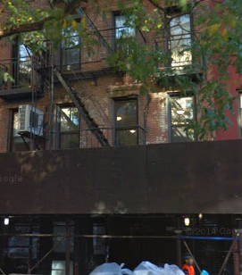
Find Where is The Repeaters
513 E 6th St. (238Complains )

Slide 16
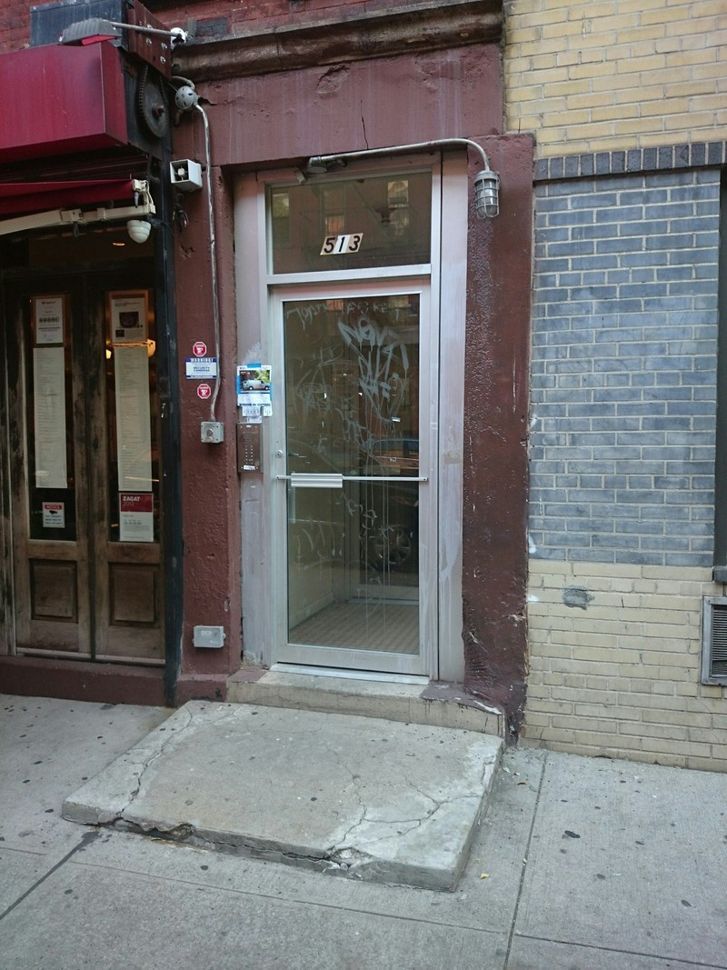
About 513 E 6th Street (From http://streeteasy.com)
8 Units | 5 Stories | Built in 1920 ( Almost 100 years buiding)OLD

Slide 17
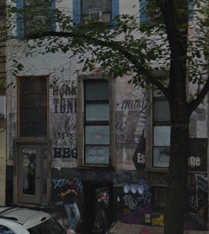
24 1st Avenue (190) 2 Units 3 Stories Built in 1900
24 1st Avenue (190)

Slide 18
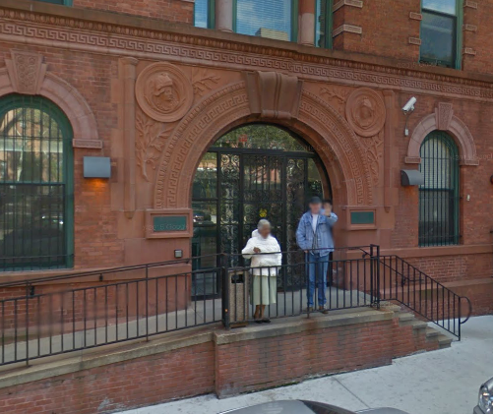
621 WATER STREET(156)
124 units 5 stories Built in 1901

Slide 19
Repeater HOT WATER/HEAT top 10
1. 513 E 6th St. (238 ) https://goo.gl/maps/37UMbMgNG582(8 Units | 5 Stories | Built in 1920 )
2. 24 1st Avenue (190) https://goo.gl/maps/GiYDEyoJpuE2(2 Units 3 Stories Built in 1900)
3. 621 WATER STREET (156) https://goo.gl/maps/aK6tMxGLrpu(124 units5 storiesBuilt in 1901)
4. 191 Avenue A(140) https://goo.gl/maps/qzRxDzcsr2r(9 units4 stories3 buildingsBuilt in 1900)
5. 239 Henry Street (129) https://goo.gl/maps/S5EWqm7wyc42(9 units5 storiesBuilt in 1900)
6. 153 Norfold St( 125) https://goo.gl/maps/gWznYcn1D5k
7. 129 2nd Ave(107) https://goo.gl/maps/qoySmCxFpd82(2 units6 storiesBuilt in 1900)
8.35 E 2nd St (104) https://goo.gl/maps/o1WzZqLiP7B2(4 units6 storiesBuilt in 2003
)
9. 197 Madison St(94) https://goo.gl/maps/Kz9NNsrFW1y20 units6 storiesBuilt in 1901
10. 163 Orchard St(90) https://goo.gl/maps/fG4w8CnLwnv(12 storiesBuilt in 2009
)

Slide 20
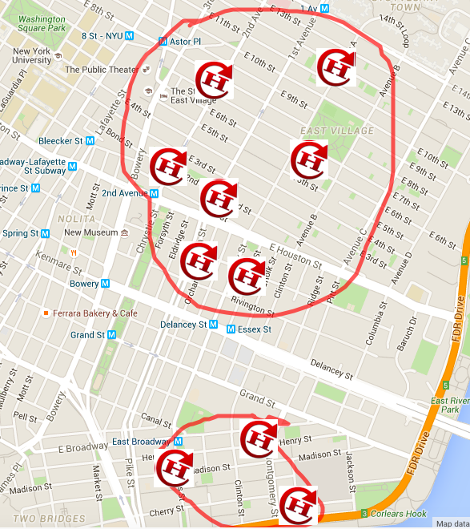
Top 10 on map
http://www.scribblemaps.com/maps/view/HeatHot_water_complains_/CB03-1

Slide 21
Explore the structure of CB03’s urban fabric
http://io.morphocode.com/urban-layers/

Slide 22
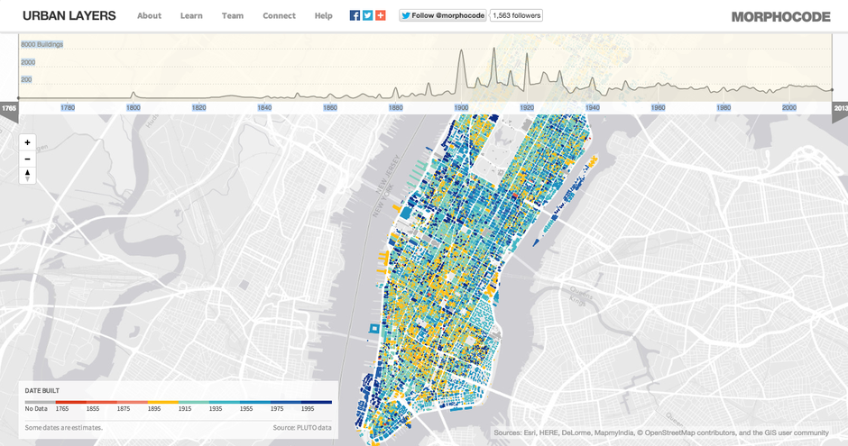

Slide 23

Rat Problems

Slide 26
Comparison Rodent
2012- June and August
2013- July and October
2014- from April to December
2015- from May to October

Slide 27
Reason for rodent
Background: Nightlife- heavy and restaurant-rich Chinatown. Food are more.
Reason: 1. summer, the food are abundant much more than other season. 2. From spring which the wheater is getting warm, more rats , then summer is a pike time of Rats.3. Near Octorber, because the temprature is getting colder or cooler, rats also have a good condtion for growing up.
Find reason, Solution 1. then we might have some solution: Limit food abundant, the reason is rats, is always because food. Solution2, Control the rats at winter, then this will affect the whole year problems.

Slide 29
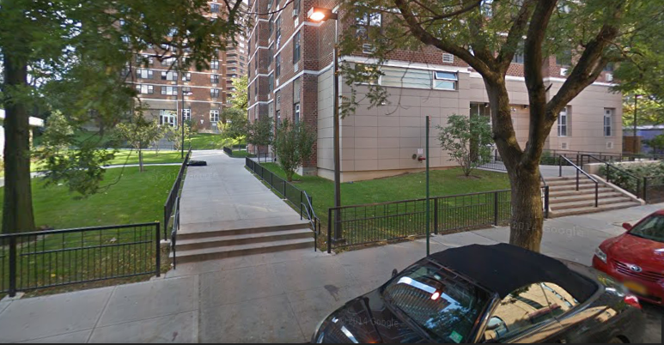
131 Broadway

Slide 30
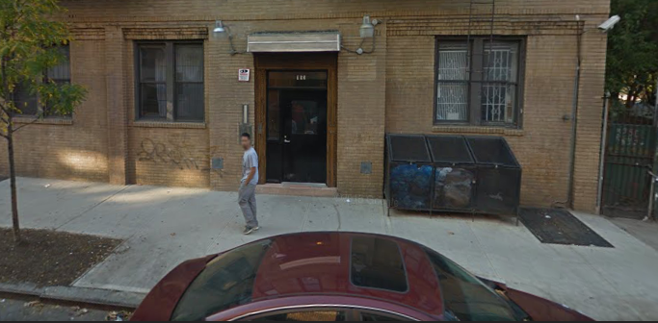
153 norfolk street

Slide 31
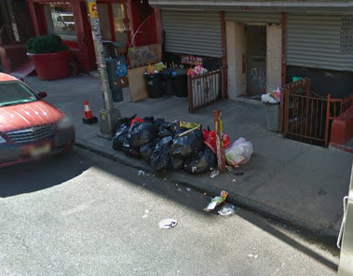
135 Eldridge St

Slide 32
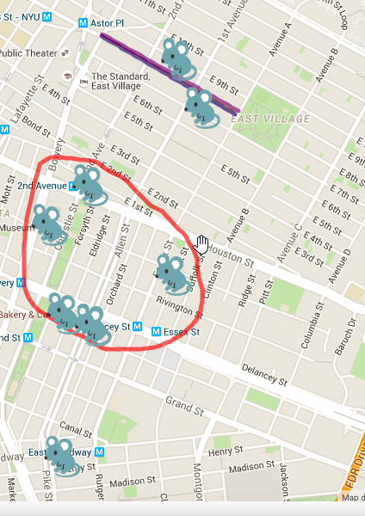
Map for top 10
http://www.scribblemaps.com/maps/view/Top_10_rats_complains_/CB03

Slide 33
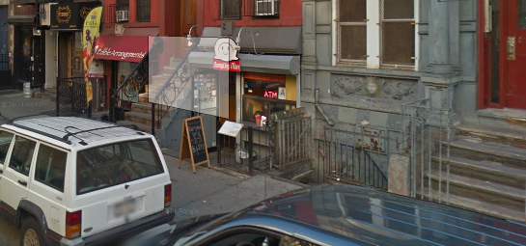
The Area I want to increase 311 requests is 98 ST MARKS PLACE( Several restaurants and night life club at the bottom of resident buidling, there must be so many rats) Method: Use posters or annocements to inform people live there use 311.

Slide 34
Street Condition

Slide 35
Street Conditions Descriptor
Cave-in (The most problem)
Pothole
Rough, Pitted or Cracked Roads

Slide 40
According to Season data
There are so many CAVE-IN complain on summer.
From 2014 POT-HOLE are being a problem all seasons.
Map for Pothole :http://www.scribblemaps.com/maps/view/Top_10_Pothole/CB03-4

Slide 41
Noise

Slide 43
Noise Hot Sports(Address and descriptor and value )
1.

Slide 44
Repeater

Slide 45
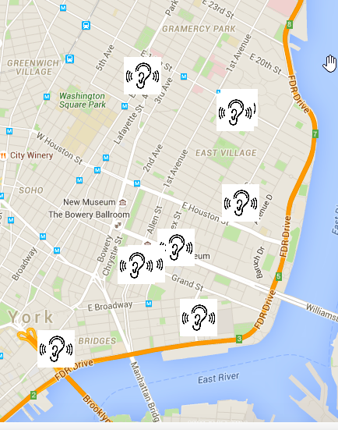
Top 10 Repeater’s map
http://www.scribblemaps.com/maps/view/Repeaters/CB03-3

Slide 46
News Related this Noise(One reason for noise)
For years, it was considered one of the more notorious stalled construction sites on the Lower East Side.
324-326 Grand Street was felled in 2008, forever ruining the quaint row of two-story dwellings between Orchard and Ludlow on the north side. An out-of-context 18-story hotel had been in the works at the time, but was not to be. The foundation poured in the aftermath of demolition would eventually sprout enough weed trees for a community garden. Another case of arrested development. That is, until DOB permits were renewed in April to reactivate the dormant space.
Shortly thereafter, the weathered concrete slab was excised and excavation onsite began anew. Then last week a sky-scraping piledriver moved into place. Ready for action. Brace yourselves for the inevitable clank-clank.
Height of the new building planned for 324-326 Grand was halved to seven stories, or 75 feet. There will be 20 total dwelling units, which equates to 13,692 square-feet of residential living space; the remaining 3,738 square-feet is reserved for commercial use.
(http://www.boweryboogie.com/2013/07/construction-reactivated-at-long-stalled-324-grand-street-site/)

Slide 47
Illegal Parking

Slide 48
Top ten addresses' illegal parking complains 2012-2015

Slide 50
Hot spots is:

Slide 52
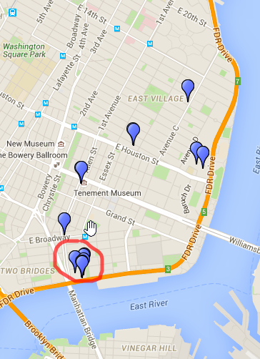
My map for top 10 address
http://www.scribblemaps.com/maps/view/Top_10_illegal_parking/CB03-2

Slide 53
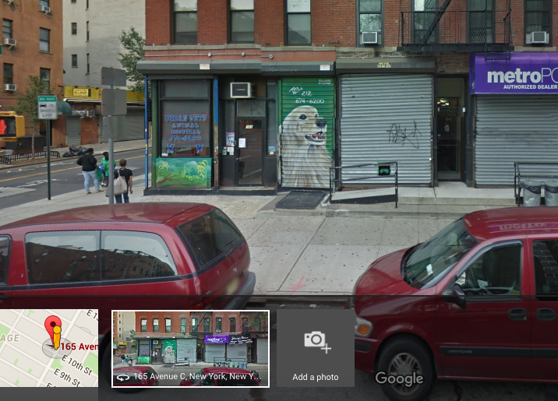
Street Scene for Constancy Illegal Paking(1) 165 Ave C

Slide 54
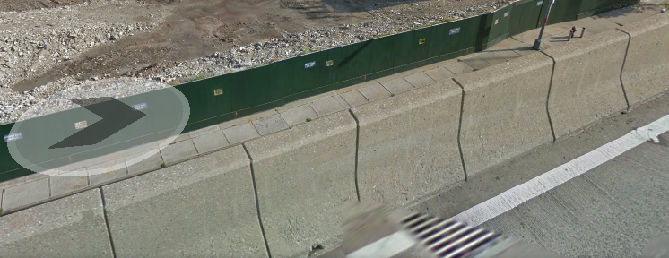
Street Scene for Constancy Illegal Paking(2) 250 South Street

Slide 55
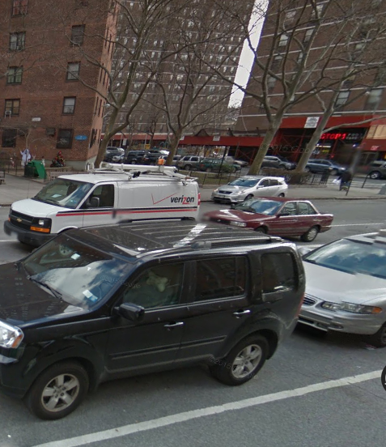
Street Scene for Constancy Illegal Paking(3) 80 Rutgers St

Slide 56
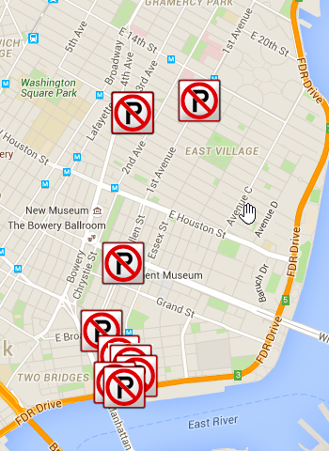
Map for consistency location illegal parking
http://www.scribblemaps.com/maps/view/Top_10consistency/CB03-5

